Slide 1
Compiler Design
Unit II
Notes:
‹#›

Slide 2
Syntax Analysis
Definition - Role of parser
Lexical versus Syntactic Analysis
Representative Grammars
Syntax Error Handling
Elimination of Ambiguity, Left Recursion
Left Factoring
Top-down parsing
Error Recovery in Predictive Parsing
Predictive Parsing Algorithm
Non Recursive Predictive Parser
Recursive Descent Parsing, back tracking
Computation of FIRST
Problems related to FIRST
Computation of FOLLOW
Problems related to FOLLOW
Construction of a predictive parsing table SLR
Predictive Parsers LL(1) Grammars
Transition Diagrams for Predictive Parsers

Slide 3
Parser
Parser is a program that obtains tokens from lexical analyzer and constructs the parse tree which is passed to the next phase of compiler for further processing.
Parser implements context free grammar for performing error checks

Slide 4
The role of parser
token
Source program
Lexical
Analyzer
Parse tree
Rest of Front
End
Intermediate representation
Parser
getNext
Token
Symbol
table
‹#›

Slide 5
Syntax Analyzer
Syntax Analyzer creates the syntactic structure of the given source program.
This syntactic structure is mostly a parse tree.
Syntax Analyzer is also known as parser.
The syntax of a programming is described by a context-free grammar (CFG). We will use BNF (Backus-Naur Form) notation in the description of CFGs.
The syntax analyzer (parser) checks whether a given source program satisfies the rules implied by a context-free grammar or not.
If it satisfies, the parser creates the parse tree of that program.
Otherwise the parser gives the error messages.
A context-free grammar
gives a precise syntactic specification of a programming language.
the design of the grammar is an initial phase of the design of a compiler.
‹#›
Notes:
lec02-parserCFG
*
‹#›

Slide 6
Parsers (cont.)
We categorize the parsers into two groups:
Top-Down Parser
the parse tree is created top to bottom, starting from the root.
Bottom-Up Parser
the parse is created bottom to top; starting from the leaves
Both top-down and bottom-up parsers scan the input from left to right (one symbol at a time).
Efficient top-down and bottom-up parsers can be implemented only for sub-classes of context-free grammars.
LL for top-down parsing
LR for bottom-up parsing
CS416 Compilr Design
‹#›

Slide 7
Lexical versus Syntactic Analysis
lexical analysis reads the source code one character at a time and converts it into meaningful lexemes (tokens) whereas syntax analysis takes those tokens and produce a parse tree as an output
lexical analyzer reads input program files and often includes buffering of that input, it is somewhat platform dependent. However, the syntax analyzer can be platform independent.
lexical analyzer usually parses in terms of regular expressions, providing output that a parser uses in the form of tokens: identifiers, strings, numbers, operators. A parser implements a higher level grammar using the tokens as input.

Slide 8
Representative Grammars
A context free grammar G is defined by four tuples as
G = (V, T, P, S)
where,
G − Grammar
V − Set of variables
T − Set of terminals
P − Set of productions
S − Start symbol

Slide 9
Representative Grammars
Terminals are symbols from which strings are formed.
Lowercase letters, i.e., a, b, c.
Operators, i.e., +,−, ∗.
Punctuation symbols, i.e., comma, paranthesis.
Digits, i.e., 0, 1, 2, · · · ,9.
Boldface letters, i.e., id, if.
Non-terminals are syntactic variables that denote a set of strings.
Uppercase letters, i.e., A, B, C.
Lowercase italic names, i.e., expr, stmt.
Start symbol is the head of the production stated first in the grammar
Production is of the form LHS → RHS or head → body, where head contains only onenon-terminal and body contains a collection of terminals and non-terminals..

Slide 10
Representative Grammars
Example
E → E + T | E − T | T
T → T ∗ F | T / F | F
F → (E) | id
V = {E, T, F}
T = {+ , −, *, /, ( , ), id}
S = {E}
P :
E → E+T T→ T / F
E → E−T T→ F
E →T F→ (E)
T → T∗F F→ id

Slide 11
Error handling
Common programming errors
Lexical errors
Syntactic errors
Semantic errors
Lexical errors
Error handler goals
Report the presence of errors clearly and accurately
Recover from each error quickly enough to detect subsequent errors
Add minimal overhead to the processing of correct programs
‹#›

Slide 12
Error Recovery Strategies
Error recovery strategies are used by the parser to recover from errors once it is detected.
The simplest recovery strategy is to quit parsing with an error message for the first error itself

Slide 13
Panic Mode Recovery
Panic mode error recovery is the easiest method of error-recovering strategy which prevents the parser from developing infinite loops.
When parser finds an error in the statement, it ignores the rest of the statement by not processing the input.
The parser intends to find designated set of synchronizing tokens by discarding input symbols one at a time.
Synchronizing tokens may be delimiters, semicolon or } whose role in source program is clear.
Advantages
Simplicity. Never get into infinite loop.
Disadvantage
Additional errors cannot be checked as some of the input symbols will be skipped.

Slide 14
Phrase Level Recovery
Parser performs local correction on the remaining input when an error is detected.
When a parser finds an error, it tries to take corrective measures so that the rest of inputs of statement allow the parser to parse ahead.
One wrong correction will lead to an infinite loop.
The local correction may be
Replacing a prefix by some string.
Replacing comma by semicolon.
Deleting extraneous semicolon.
Insert missing semicolon.

Slide 15
Phrase Level Recovery
Advantage
It can correct any input string.
Disadvantage
It is difficult to cope up with actual error if it has occurred before the point of detection.

Slide 16
Error Production
Productions which generate erroneous constructs are augmented to the grammar by considering common errors that occur.
These productions detect the anticipated errors during parsing.
Error diagnostics about the erroneous constructs are generated by the parser.

Slide 17
Global Correction
There are algorithms which make changes to modify an incorrect string into a correct string.
These algorithms perform minimal sequence of changes to obtain globally least-cost correction.
When a grammar G and an incorrect string p is given, these algorithms find a parse tree for a string q related to p with smaller number of transformations.
The transformations may be insertions, deletions and change of tokens.
Advantage
It has been used for phrase level recovery to find optimal replacement strings.
Disadvantage
This strategy is too costly to implement in terms of time and space.

Slide 18
Derivations
Productions are treated as rewriting rules to generate a string
Rightmost and leftmost derivations
– E -> E + E | E * E | -E | (E) | id
Derivations for –(id+id)
E => -E => -(E) => -(E+E) => -(id+E)=>-(id+id)
E => -E => -(E) => -(E+E) => -(E+id)=>-(id+id)
‹#›

Slide 19
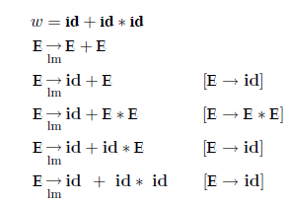
Leftmost Derivation
At each and every step the leftmost non-terminal is expanded by substituting its corresponding production to derive a string.
E → E + E | E ∗ E | id
Let

Slide 20
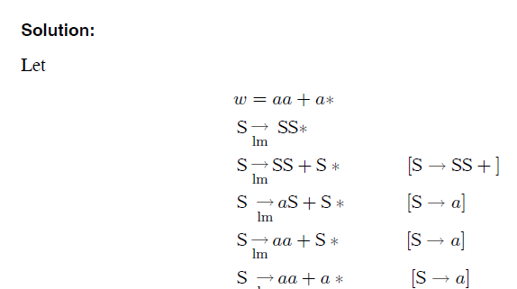
Leftmost Derivation
S → SS + | SS ∗ | a
{Students use leftmost derivations to derive the string w=aa+a* using the above productions}

Slide 21
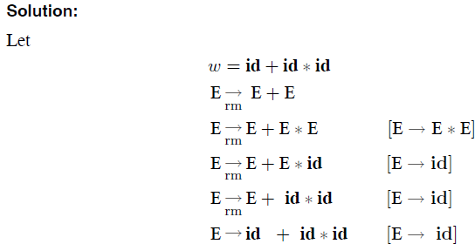
Rightmost Derivation
at each and every step the rightmost non-terminal is expanded by substituting its corresponding production to derive a string.
E → E + E | E ∗ E | id

Slide 22
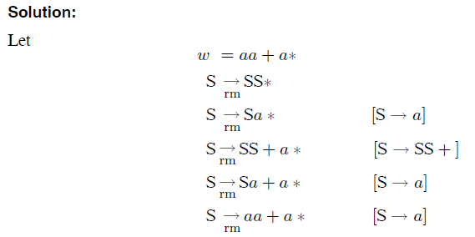
Rightmost Derivation
S → SS + | SS ∗ | a
{Students use rightmost derivations to derive the string w=aa+a* using the above productions}

Slide 23
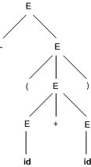
Parse tree
Parse tree is a hierarchical structure which represents the derivation of the grammar to yield input strings.
Root node of parse tree has the start symbol of the given grammar from where the derivation proceeds.
Leaves of parse tree represent terminals.
Each interior node represents productions of grammar.
If A → xyz is a production, then the parse tree will have A as interior node whose children are x, y and z from its left to right.
‹#›

Slide 24
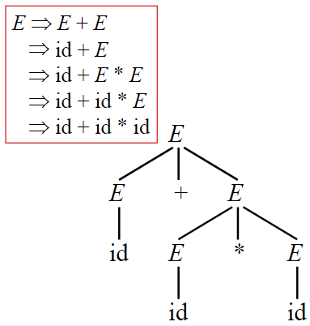
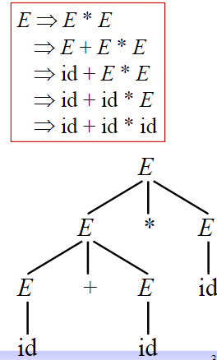
Ambiguity
A grammar is said to be ambiguous if there exists more than one leftmost derivation or more than one rightmost derivative or more than one parse tree for the given input string. If the grammar is not ambiguous then it is called unambiguous.
LMD
RMD
‹#›

Slide 25
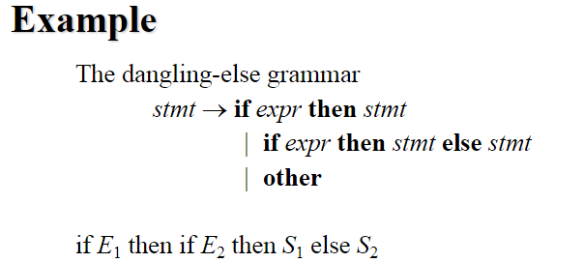
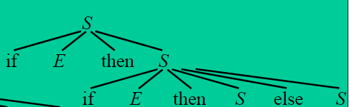
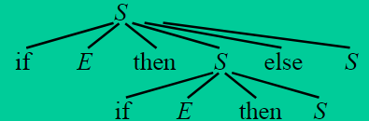
Elimination of ambiguity
‹#›

Slide 26
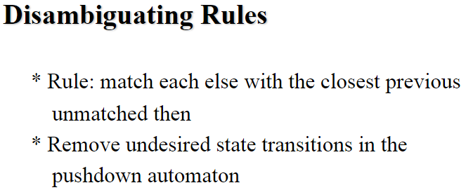
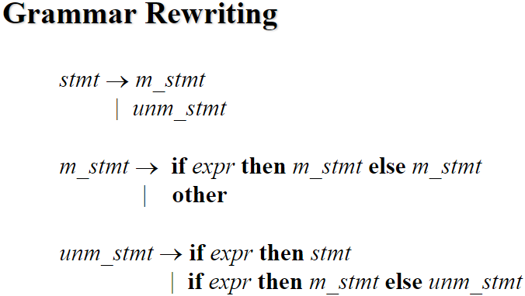
Elimination of ambiguity (cont.)
‹#›

Slide 27
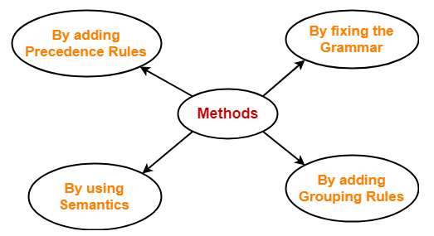
Elimination of ambiguity (cont.)
‹#›

Slide 28
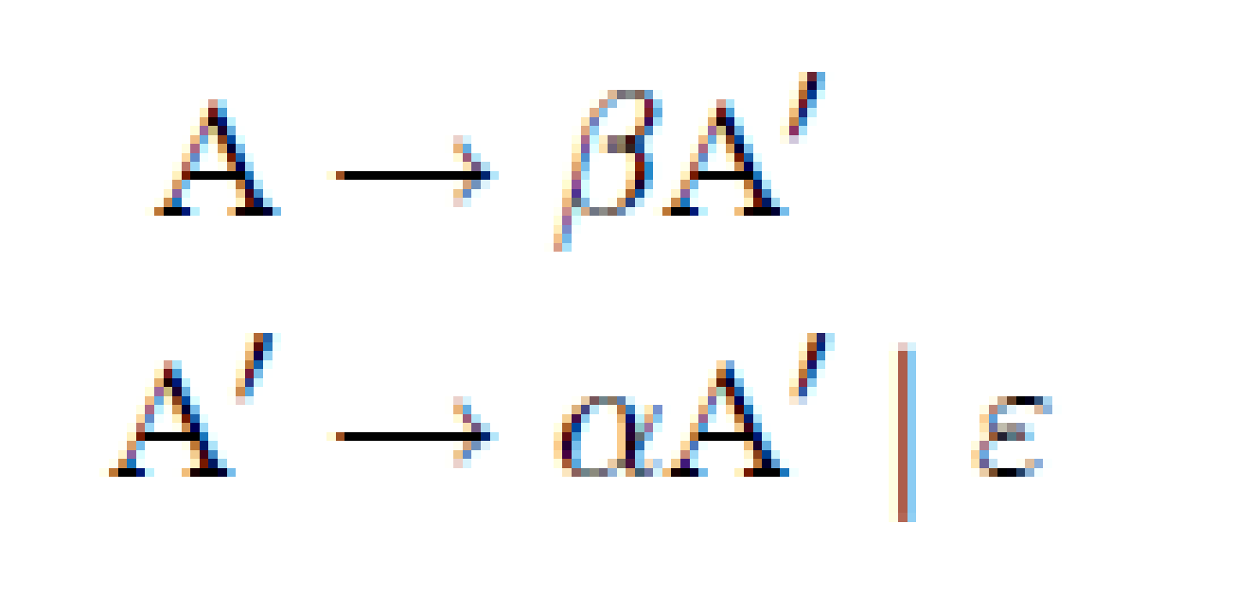
Eliminating left-recursion
A grammar is left recursive if it has a production of the form A→Aα, for some string α. To eliminate left-recursion for the production, A→A α | β.
If a left recursion is present in any grammar then, during parsing in the the syntax analysis part of compilation there is a chance that the grammar will create infinite loop. This is because at every time of production of grammar S will produce another S without checking any condition.
Left recursive grammar: A→A α | β
After elimination of LR:

Slide 29
Eliminating left-recursion
A grammar is left recursive if it has a production of the form A→Aα, for some string α. To eliminate left-recursion for the production, A→A α | β.
If a left recursion is present in any grammar then, during parsing in the the syntax analysis part of compilation there is a chance that the grammar will create infinite loop. This is because at every time of production of grammar S will produce another S without checking any condition.
Left recursive grammar: A→A α | β
After elimination of LR:

Slide 30
Left Recursion Elimination Example
E -> TE’
E -> E+T | T T -> T*F | F
F -> (E) | id
E’ -> +TE’ | ε T -> FT’
T’ -> *FT’ | ε F -> (E) | id
‹#›

Slide 31
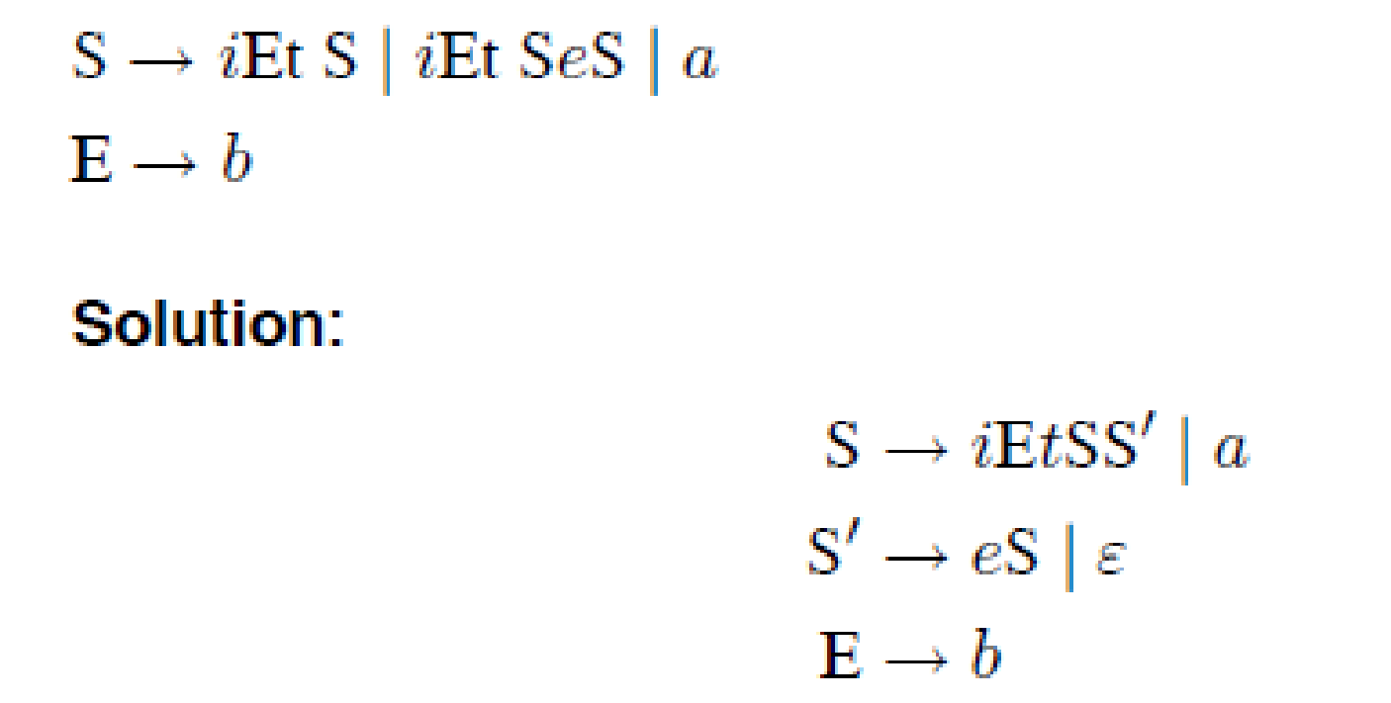
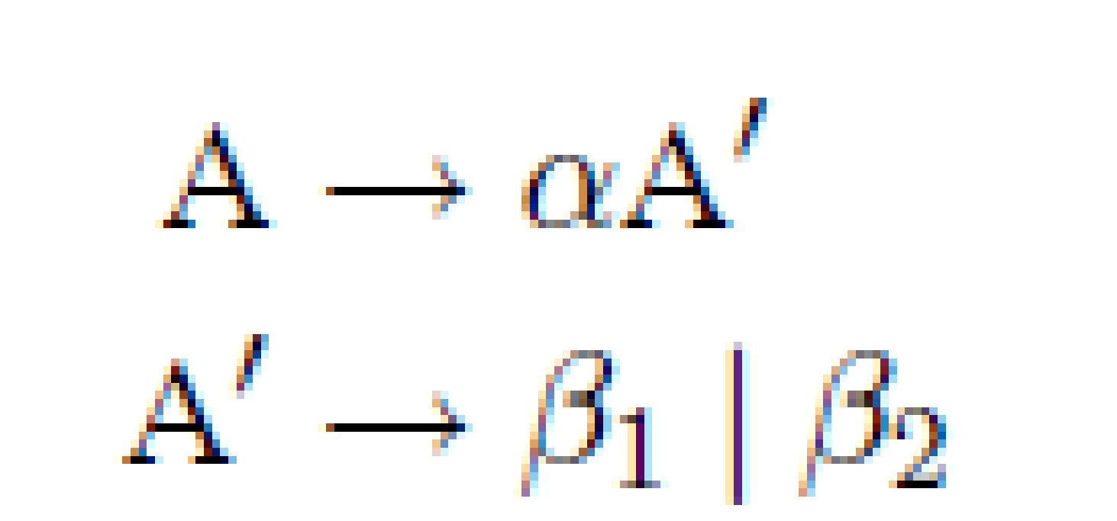
Left factoring
When a production has more than one alternatives with common prefixes, then it is necessary to make right choice on production.
It is a grammar transformation technique.
Left factoring is removing the common left factor that appears in two productions of the same non-terminal. It is done to avoid back-tracing by the parser
To perform left-factoring for the production, A→ αβ1|αβ2
Rule

Slide 32
Left factoring
Left recursion: when one or more productions can be reached from themselves with no tokens consumed in-between.
Left factoring: a process of transformation, turning the grammar from a left-recursive form to an equivalent non-left-recursive form.

Slide 33
Top-Down Parsing
Top-down parsing constructs parse tree for the input string, starting from root node and creating the nodes of parse tree in pre-order.
Top-down parsing is characterized by the following methods:
Brute-force method, accompanied by a parsing algorithm. All possible combinations are attempted before the failure to parse is recognized.
Recursive descent, is a parsing technique which does not allow backup. Involves backtracking and left-recursion.
Top-down parsing with limited or partial backup.

Slide 34
Recursive Descent Parser
Recursive descent parser is a top-down parser.
It requires backtracking to find the correct production to be applied.
The parsing program consists of a set of procedures, one for each non-terminal.
Process begins with the procedure for start symbol.
Start symbol is placed at the root node and on encountering each non-terminal, the procedure concerned is called to expand the non-terminal with its corresponding production.
Procedure is called recursively until all non-terminals are expanded.
Successful completion occurs when the scan over entire input string is done, i.e., all terminals in the sentence are derived by parse tree.

Slide 35
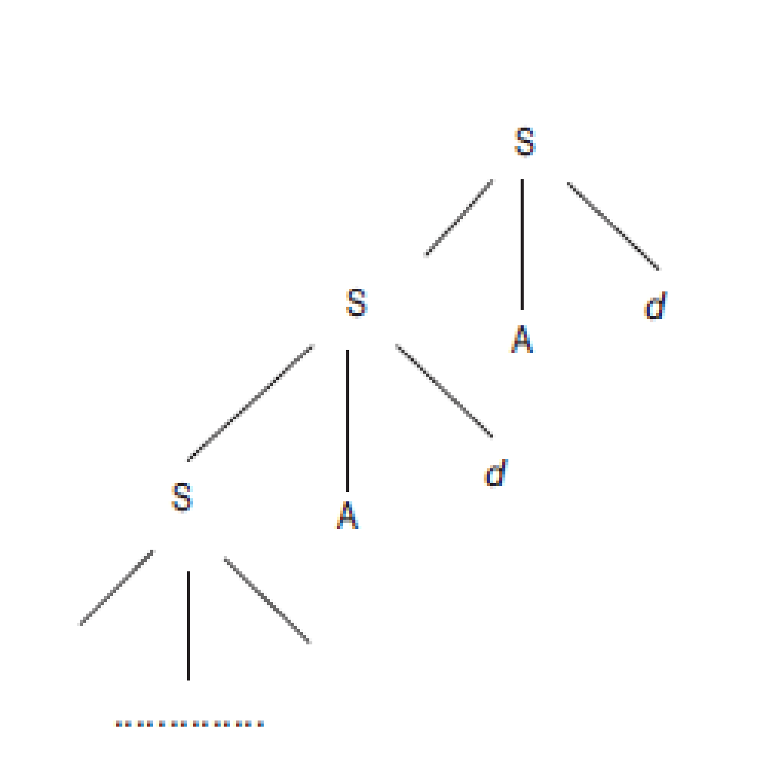
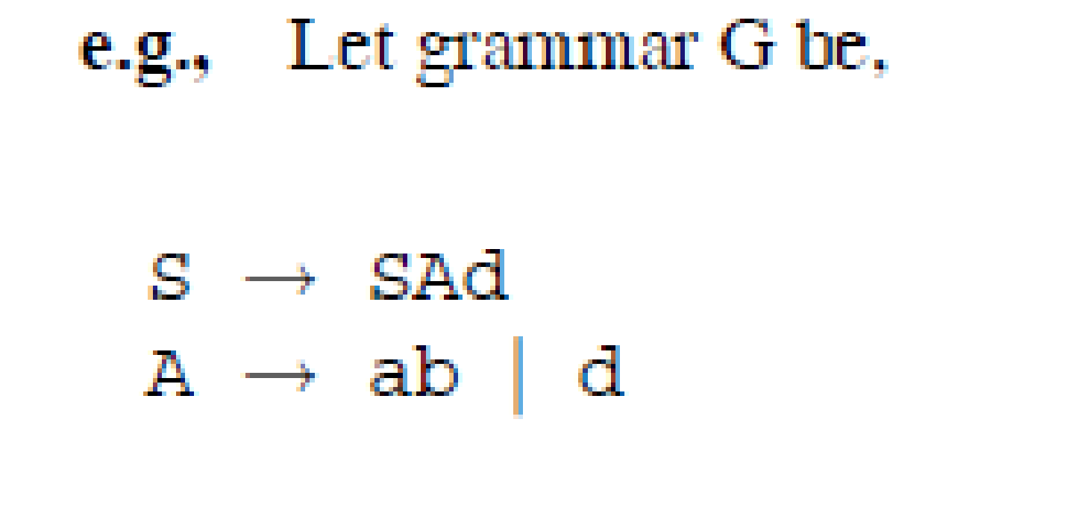
Recursive Descent Parser
Limitation
When a grammar with left recursive production is given, then the parser might get into infinite loop.

Slide 36
Recursive descent parser with backtracking
The root node contains the start symbol which is S.
The body of production begins with c, which matches with the first symbol of the input string.
A is a non-terminal which is having two productions A → ab | d.
Apply the first production of A, which results in the string cabd that does not match with the given string cad.
Backtrack to the previous step where the production of A gets expanded and try with alternate production of it.
This produces the string cad that matches with the given string.

Slide 37
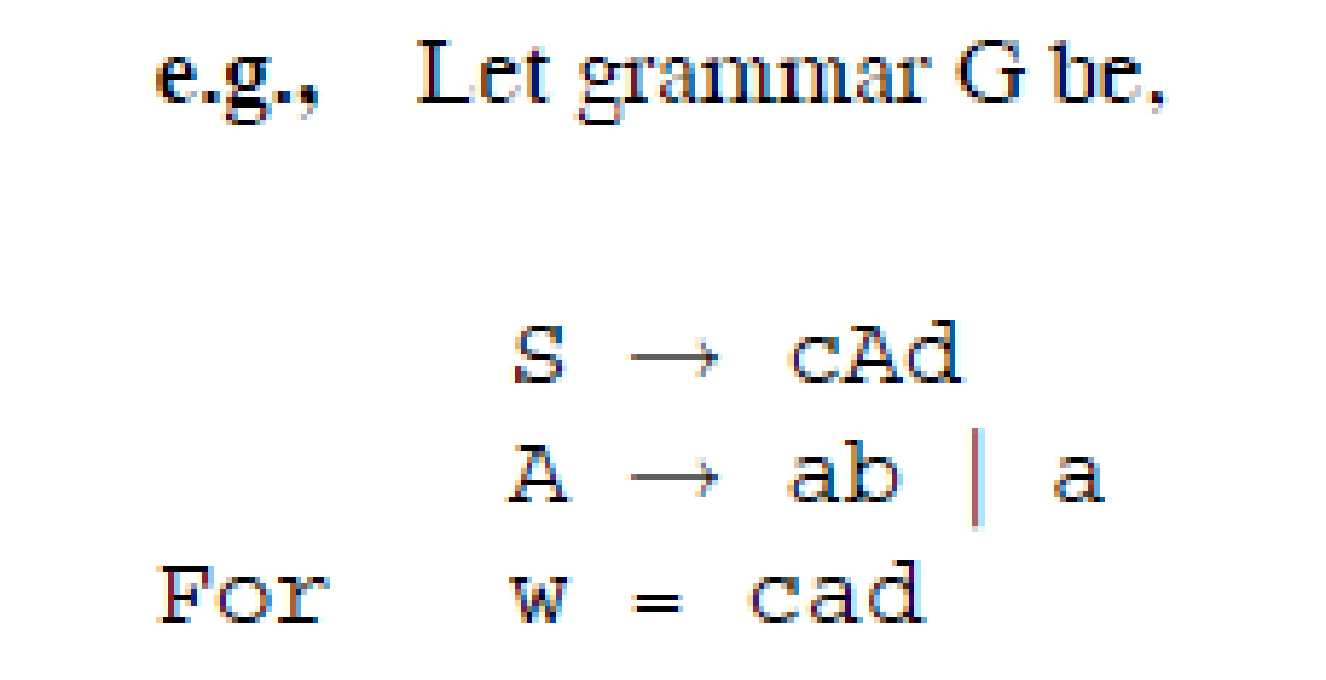
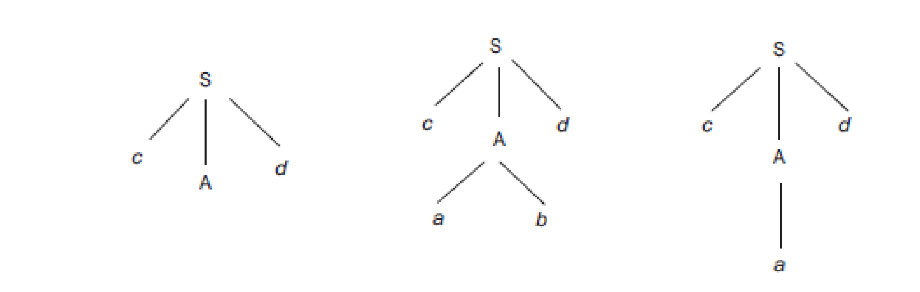
Recursive descent parser with backtracking

Slide 38
Recursive descent parser with backtracking
Limitation:
If the given grammar has more number of alternatives then the cost of backtracking will be high

Slide 39
Recursive descent parser without backtracking
Recursive descent parser without backtracking works in a similar way as that of recursive descent parser with backtracking with the difference that each non-terminal should be expanded by its correct alternative in the first selection itself.
When the correct alternative is not chosen, the parser cannot backtrack and results in syntactic error
Advantage
Overhead associated with backtracking is eliminated.
Limitation
-- When more than one alternative with common prefixes occur, then the selection of the correct alternative is highly difficult.

Slide 40
Predictive Parser / LL(1) Parser
Predictive parsers are top-down parsers.
It is a type of recursive descent parser but with no backtracking.
It can be implemented non-recursively by using stack data structure.
They can also be termed as LL(1) parser as it is constructed for a class of grammars called LL(1).
The production to be applied for a non-terminal is decided based on the current input symbol.

Slide 41
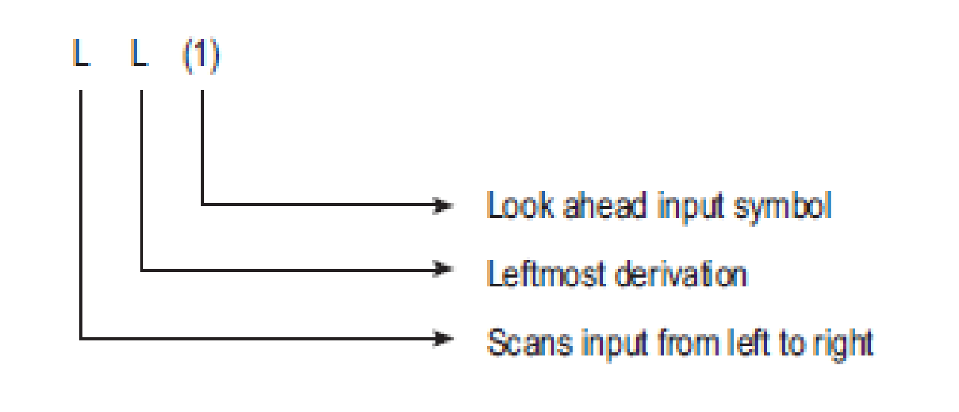
Predictive Parser / LL(1) Parser
In order to overcome the limitations of recursive descent parser, LL(1) parser is designed by using stack data structure explicitly to hold grammar symbols.
In addition to this, Left-recursion is eliminated.
Common prefixes are also eliminated (left-factoring).

Slide 42
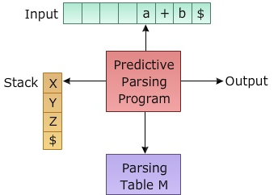
Predictive Parser / LL(1) Parser
INPUT: Contains string to be parsed with $ as it's end marker
STACK: Contains sequence of grammar symbols with $ as it's bottom marker. Initially stack contains only $
PARSING TABLE: A two dimensional array M[A,a], where A is a non-terminal and a is a Terminal
It is a tabular implementation of the recursive descent parsing, where a stack is maintained by the parser rather than the language in which parser is written
Implementation of a Predictive Parser:
Predictive parser use an algorithm to parse the input string, which makes use of entries in a table which are filled by using another algorithm using two important set computed for the given gramma

Slide 43
Steps in Predictive Parsing
Eliminate Left Recursion
Left factor the grammar
Compute FIRST () and FOLLOW()
Build the predictive parsing table using the FIRST() and FOLLOW() elements

Slide 44
Computation of FIRST
FIRST(α) is the set of terminals that begin strings derived from α.
Rules
To compute FIRST(X), where X is a grammar symbol,
If X is a terminal, then FIRST(X) = {X}.
If X → ε is a production, then add ε to FIRST(X).
If X is a non-terminal and X → Y1 Y2 ··· Yk is a production, then add FIRST(Y1) to FIRST(X). If Y1 derives ε, then add FIRST(Y2) to FIRST(X).

Slide 45
Computation of FOLLOW
FOLLOW(A) is the set of terminals a, that appear immediately to the right of A. For rightmost sentential form of A, $ will be in FOLLOW(A).
Rules
For the FOLLOW(start symbol) place $, where $ is the input end marker.
If there is a production A → αBβ, then everything in FIRST(β) except ε is in FOLLOW(B).
If there is a production A → αB, or a production A → αBβ where FIRST(β) contains ε, then everything in FOLLOW(A) is in FOLLOW(B).

Slide 46
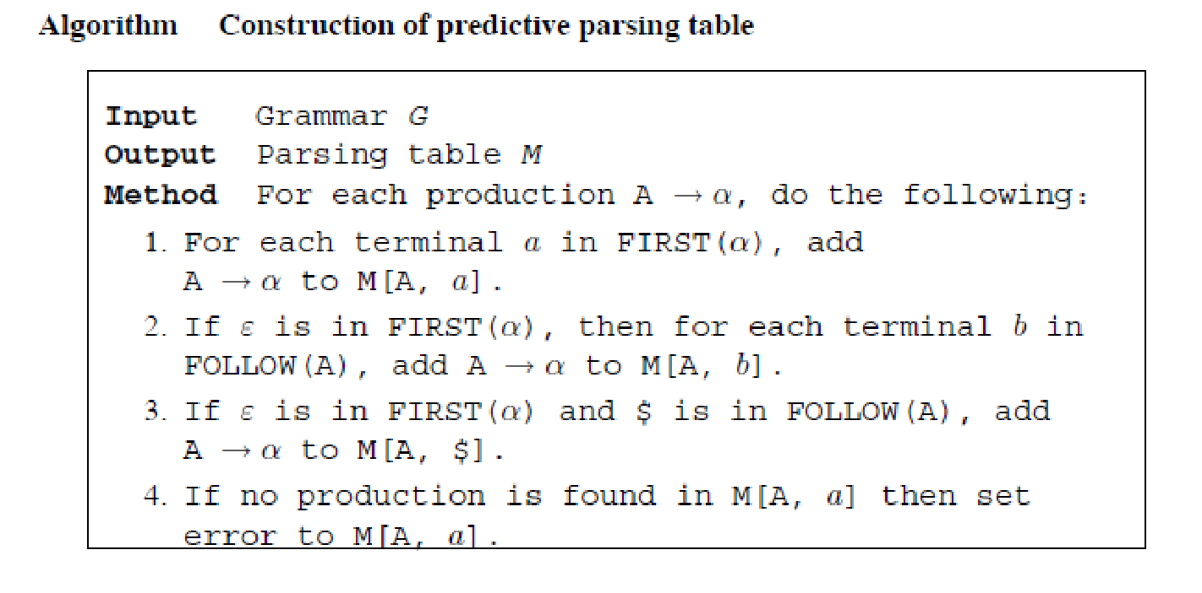
Construction of parsing table

Slide 47
Parsing of input
Predictive parser contains the following components:
Stack − holds sequence of grammar symbols with $ on the bottom of stack
Input buffer − contains the input to be parsed with $ as an end marker for the string.
Parsing table.

Slide 48
Parsing of input - Process
Initially the stack contains $ to indicate bottom of the stack and the start symbol of grammar on top of $.
The input string is placed in input buffer with $ at the end to indicate the end of the string.
Parsing algorithm refers the grammar symbol on the top of stack and input symbol pointed by the pointer and consults the entry in M[A, a] where A is in top of stack and a is the symbol read by the pointer.
Based on the table entry, if a production is found then the tail of the production is pushed onto stack in reversal order with leftmost symbol on the top of stack.
Process repeats until the entire string is processed.

Slide 49
Parsing of input - Process
When the stack contains $ (bottom end marker) and the pointer reads $ (end of input string), successful parsing occurs.
If no entry is found, it reports error stating that the input string cannot be parsed by the grammar

Slide 50
Non-recursive Predictive Parser
Non-recursive predictive parser uses explicit stack data structure.
This prevents implicit recursive calls.
It can also be termed as table-driven predictive parser.
Components
Input buffer − holds input string to be parsed.
Stack − holds sequence of grammar symbols.
Predictive parsing algorithm − contains steps to parse the input string; controls the parser’s process.
Parsing table − contains entries based on which parsing actions has to be carried out.

Slide 51
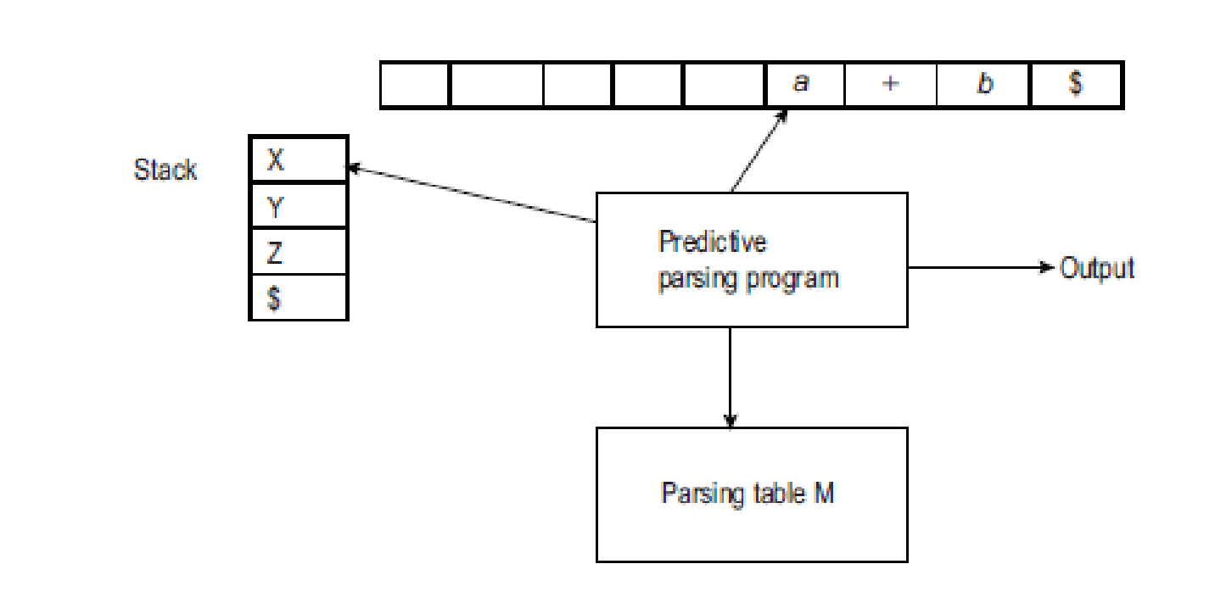
Model of a table-driven predictive parser

Slide 52
Process
Initially, the stack contains $ at the bottom of the stack.
The input string to be parsed is placed in the input buffer with $ as the end marker.
If X is a non-terminal on the top of stack and the input symbol being read is a, the parser chooses a production by consulting entry in the parsing table M[X, a].

Slide 53
Process
Replace the non-terminal in stack with the production found in M[X, a] in such a way that the leftmost symbol of right side of production is on the top of stack, i.e., the production has to be pushed to stack in reverse order.
Compare the top of stack symbol with input symbol.
If it matches, pop the symbol from stack and advance the pointer reading the input buffer.
If no match is found repeat from step 2. Stop parsing when the stack is empty (holds $) and input buffer reads end marker ($).

Slide 54
Example
Construct predictive parsing table for the grammar,
E → E + T | T
T → T ∗ F | F
F → (E) | id
and parse the input id + id∗id.

Slide 55
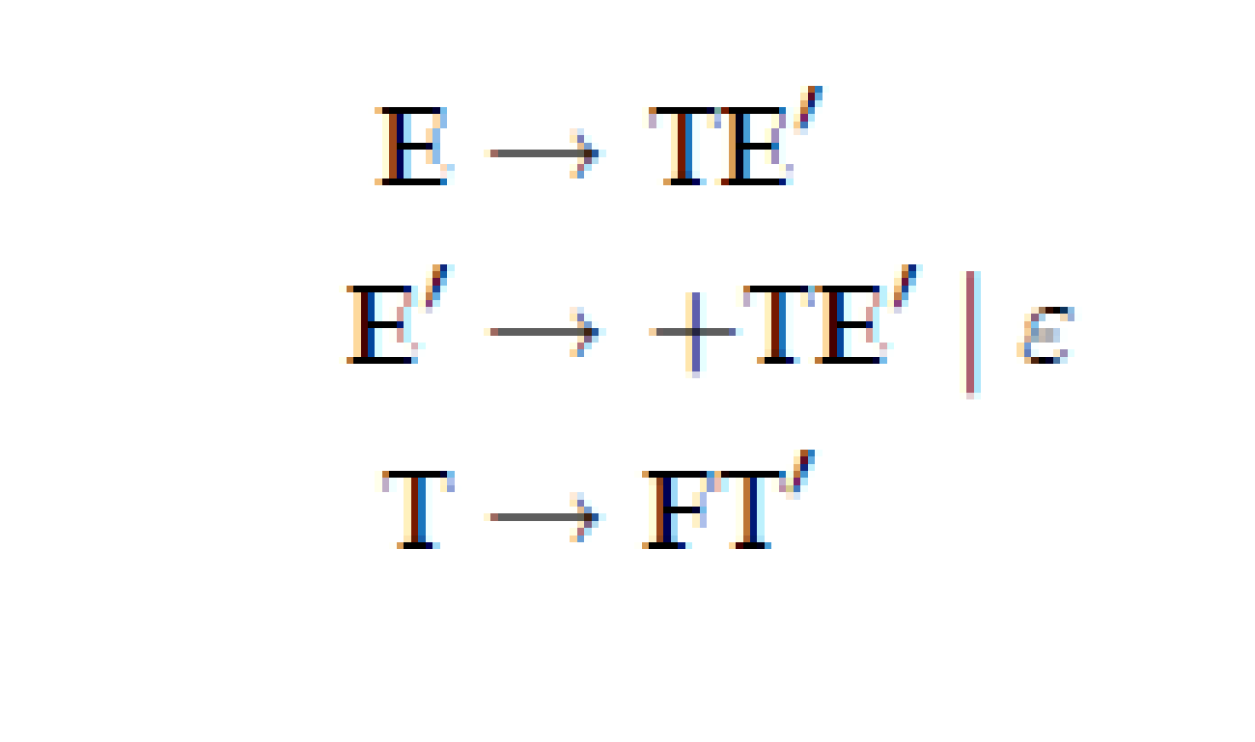
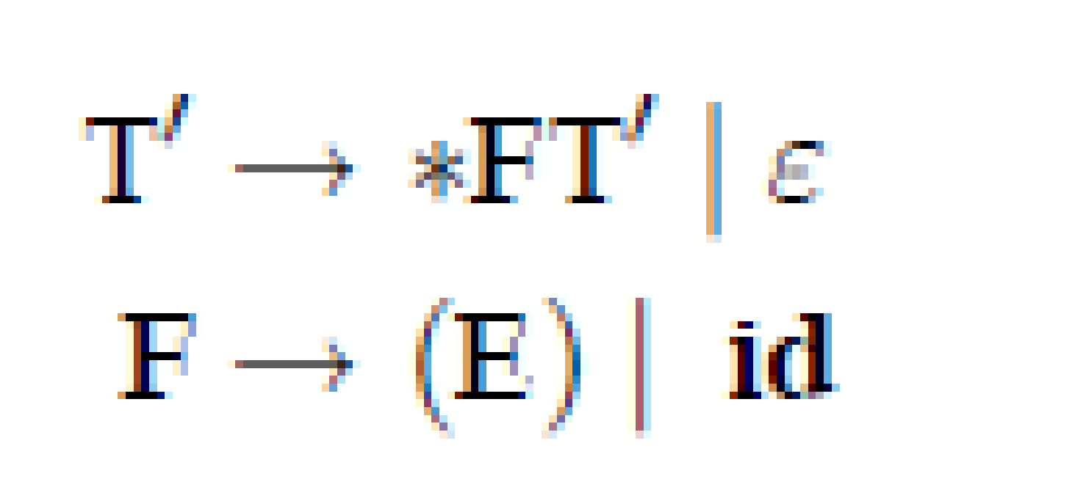
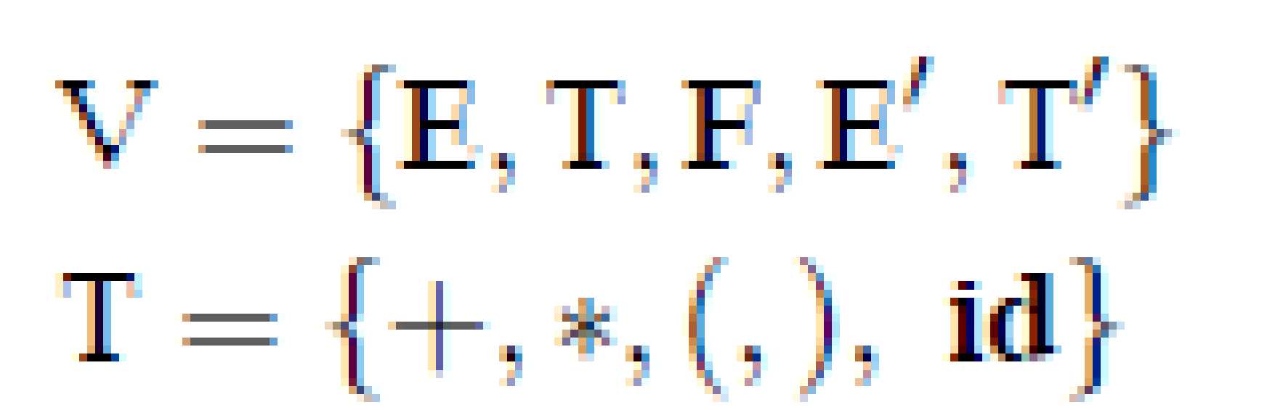
Solution
Step 1: Eliminate left-recursion

Slide 56
Solution
Step 2: Left-factoring No common prefixes for any production with same head, i.e., no need of left-factoring

Slide 57
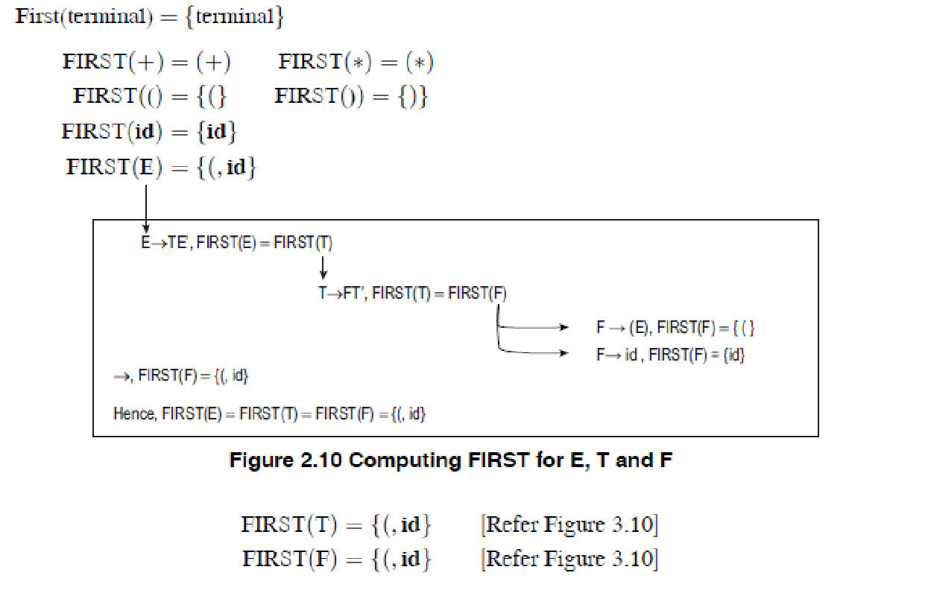
Step 3: Compute FIRST

Slide 58
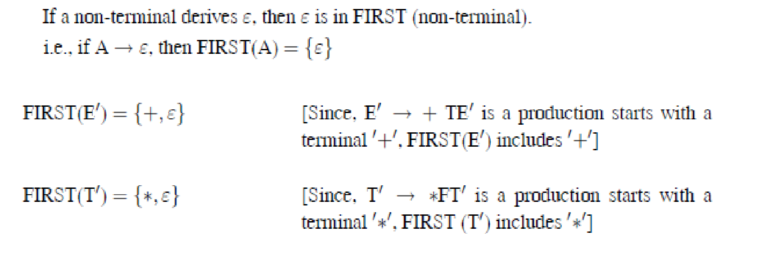
Step 3: Compute FIRST

Slide 59
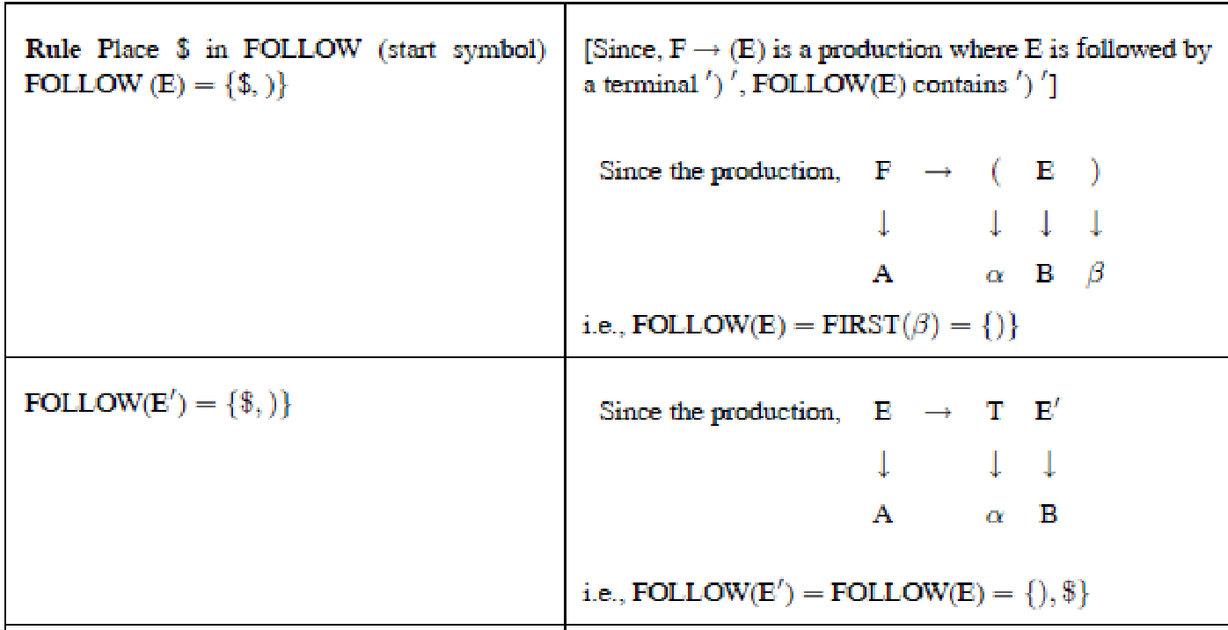
Step 4: Compute FOLLOW

Slide 60
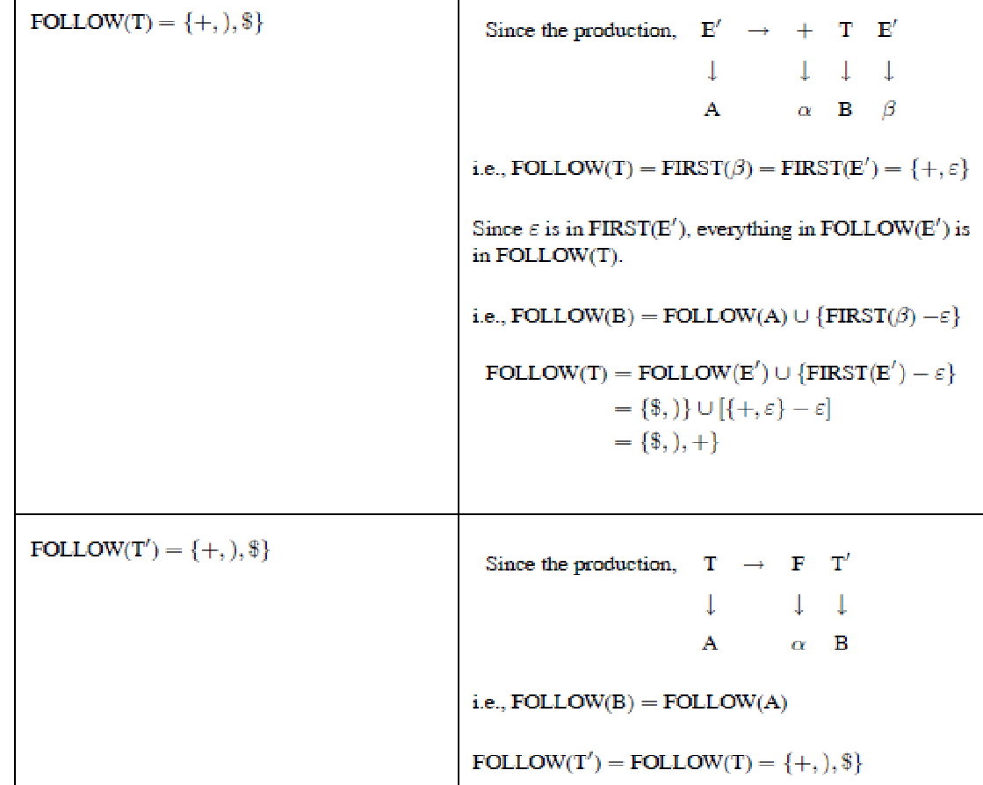
Step 4: Compute FOLLOW

Slide 61
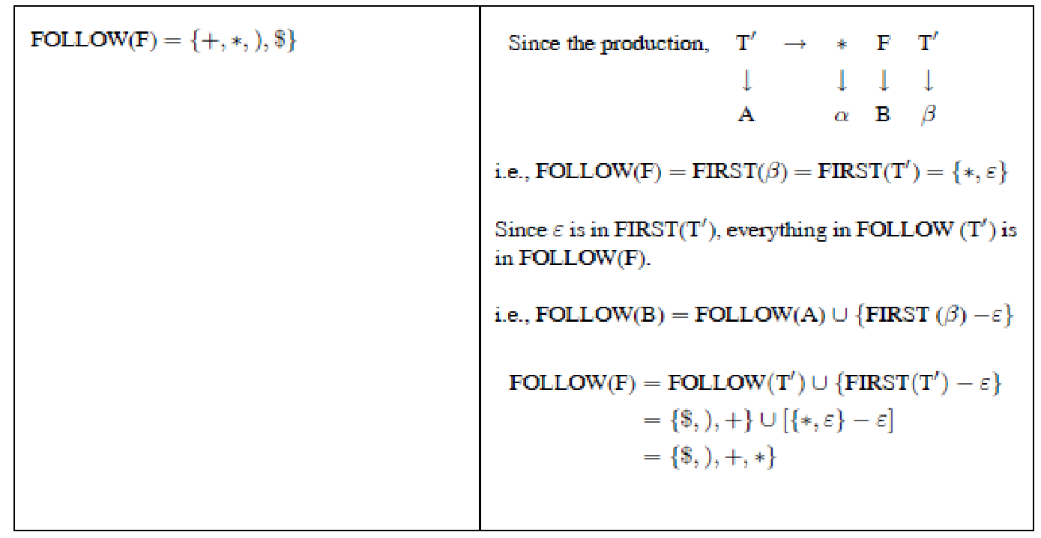
Step 4: Compute FOLLOW

Slide 62
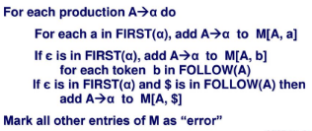
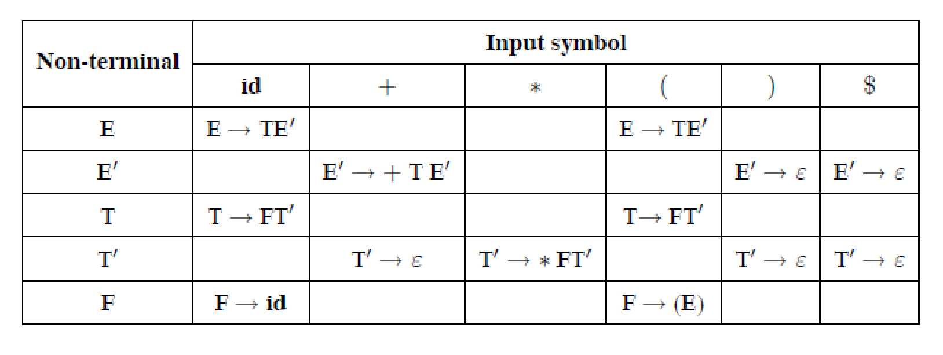
Step 5: Construct parsing table

Slide 63
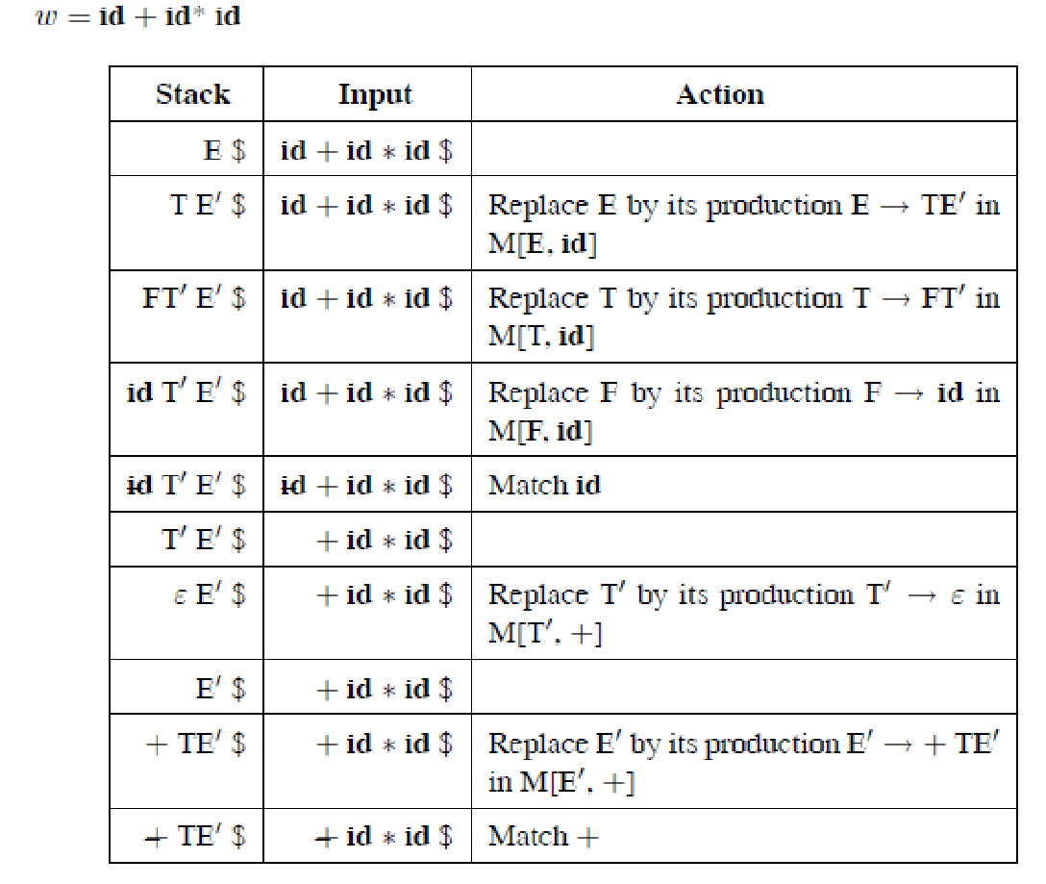
Step 6: Parse the given input

Slide 64
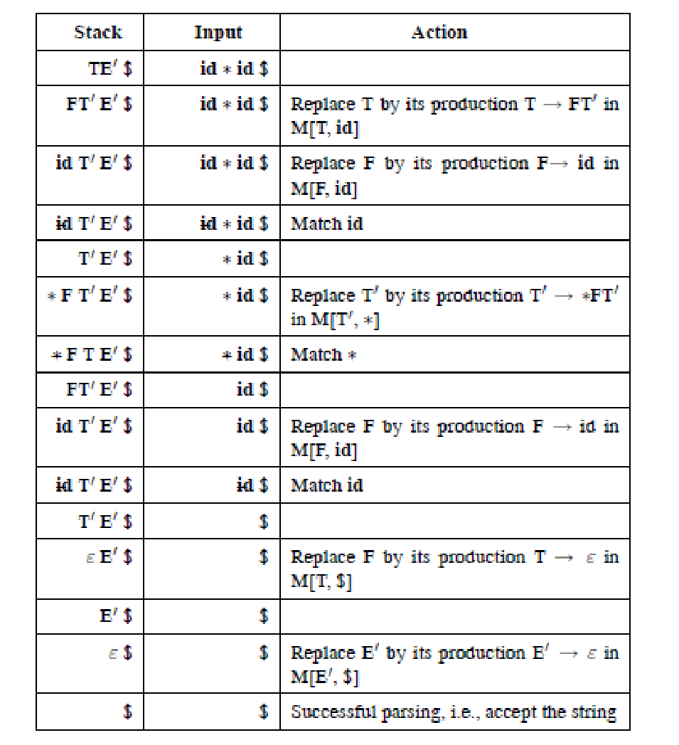

Slide 65
Example 2
Construct predictive parsing table for the grammar,
S → S(S)S | ε
with the input (( ) ( )).

